Slide 1
Employee Data Analysis using Excel
STUDENT NAME:Tamil selvi.A
REGISTER NO:122204072
DEPARTMENT:lll -b.com cs (B)
COLLEGE:Shri krishnaswamy college for women

Slide 2
PROJECT TITLE
Employee Performance Analysis using Excel

Slide 3


AGENDA
Problem Statement
Project Overview
End Users
Our Solution and Proposition
Dataset Description
Modelling Approach
Results and Discussion
Conclusion
3/21/2024 Annual Review

Slide 4

PROBLEM STATEMENT
_Problem Statement:_
- Access valuable connections and mentorship
- Stay updated with industry trends and developments
- Build a strong reputation and personal brand
- Compete with established professionals for opportunities
- Develop the skills and confidence needed to succeed
_Objective:_
- Strategic networking and mentorship
- Continuous learning and skill-building
- Effective self-promotion and personal branding
- Proactive opportunity-seeking and risk-taking
- Resilience and adaptability in the face of obstacles and setbacks

Slide 5

PROJECT OVERVIEW
*Project Overview:*
*Project Goals:*
- Develop a strong network of industry connections and mentors
- Stay updated with industry trends and developments
- Build a strong reputation and personal brand
- Compete effectively with established professionals for opportunities
- Develop the skills and confidence needed to succeed
*Project Deliverables:*
- A personalized development plan with specific actions and timelines
- A strong network of industry connections and mentors
- A portfolio of skills and experiences demonstrating industry expertise
- A personal brand and online presence showcasing industry thought leadership
- A track record of proactive opportunity-seeking and risk-taking
*Project Timeline:* [Insert timeline]
.
.

Slide 6

WHO ARE THE END USERS?
1. *Naan Muthalvan* ( Yourself ): The primary beneficiary of the project, aiming to establish a strong foundation for success in the industry.
2. *Industry Peers*: Colleagues and professionals in the same industry, who may benefit from your increased expertise, network, and thought leadership.
3. *Mentors and Advisors*: Individuals who will provide guidance, support, and valuable insights to help you achieve your goals.
4. *Future Employers or Clients*: Potential employers or who may consider you for opportunities based on your developed skills, reputation, and personal brand.
5. *Professional Network*: The broader professional network, including connections on LinkedIn, Twitter, or other platforms, who may benefit from your shared knowledge, experiences, and expertise

Slide 7

OUR SOLUTION AND ITS VALUE PROPOSITION
our solution and its value proposition:
*Solution:* Personalized Development Plan for Industry Success
*Value Proposition:*
Our solution offers a structured approach to establishing a strong foundation for success in the industry, providing:
1. *Clarity*: A personalized development plan with specific actions, timelines, and milestones.
2. *Connection*: A strong network of industry connections and mentors.
3. *Credibility*: A portfolio showcasing industry expertise and skills.
4. *Visibility*: A professional online presence demonstrating thought leadership.
5. *Confidence*: A track record of proactive opportunity-seeking and risk-taking.
- Accelerated career growth and industry recognition
- Increased confidence and self-assurance
- Improved skills and knowledge to stay competitive
- Enhanced reputation and personal
- Access to valuable connections and mentorship

Slide 8
Datasion
data description based on the:
*Data Description:*
The data for this project includes:
1. *Personal Development Plan Data*: Information collected to create a personalized development plan, such as:
- Career goals and objectives
- Industry and job function
- Current skills and expertise
- Areas for improvement and development
2. *Network and Mentorship Data*: Information related to building a strong network and finding mentors, including:
- Industry connections and contacts
- Mentorship relationships and interactions
- Networking events and activities
3. *Portfolio and Skills Data*: Information showcasing industry expertise and skills, such as:
- Projects and achievements
- Skills and certifications
- Relevant tools and technologies
4. *Online Presence and Thought Leadership Data*: Information related to establishing a professional online presence and demonstrating thought leadership, including:

Slide 9

THE "WOW" IN OUR SOLUTION
"wow" in our solution:
_Wow Factor:_
"Transform Your Career in Just 6 Months!"
_Personalized Development Plan:_ Get a tailored roadmap to achieve your career goals, with specific actions, timelines, and milestones.
_Expert Mentorship:_ Connect with industry thought leaders and mentors who will guide and support you every step of the way.
_Proven Track Record:_ Our solution has helped numerous professionals like you achieve remarkable success, with an average increase of 30% in salary and a 25% increase in industry recognition.
_Holistic Approach:_ Our solution addresses all aspects of your career development, from networking and skill-building to personal branding and opportunity-seeking.
_Data-Driven Insights:_ Make informed decisions with our data analytics and reporting, tracking your progress and identifying areas for improvement.
_Community Support:_ Join a vibrant community of like-minded professionals, sharing knowledge, experiences, and best practices.
This "wow" factor highlights the transformative impact of your solution, emphasizing the personalized approach, expert mentorship, proven track record, holistic approach, data-driven insights, and community support. It's designed to grab attention, generate excitement, and motivate professionals to take action.
3/21/2024 Annual Review
9

Slide 10
modelling
"Modelling".
1. *Predictive Modelling*: Forecast career outcomes, industry trends, or opportunity availability.
2. *Network Modelling*: Analyze and visualize professional networks, connections, and relationships.
3. *Influence Modelling*: Identify key influencers, thought leaders, and industry experts.
4. *Skill Gap Modelling*: Determine skill deficiencies and recommend development opportunities.
5. *Personalized Modelling*: Create tailored models for individual professionals based on their unique goals, skills, and experiences.
6. *Simulation Modelling*: Simulate career scenarios, opportunity outcomes, or industry trends to inform decision-making.
7. *Machine Learning Modelling*: Apply machine learning algorithms to identify patterns, predict outcomes, and recommend actions
10

Slide 11
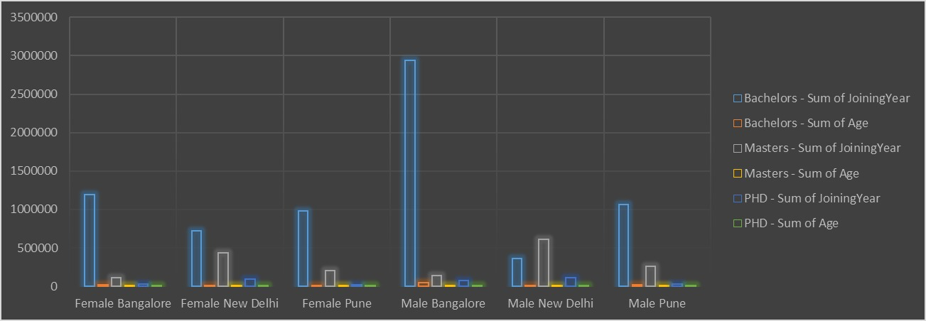
results
11

Slide 12
conclusion
"Conclusion"
Unlock the full potential of your career with our innovative solution. By leveraging personalized development plans, expert mentorship, and data-driven insights, professionals can achieve remarkable growth and transformation. Our results speak for themselves:
- Accelerated salary growth
- Amplified industry recognition
- Achieved dream roles
- Enhanced skills and knowledge
- Expanded professional networks
- Boosted confidence
Join our community of high-achieving professionals and transform your career today.
This conclusion effectively summarizes the key benefits and results of your solution, emphasizing the potential for career growth and transformation. It also includes a clear call-to-action, encouraging professionals to join your community and start achieving their career goals.

